Slide 1
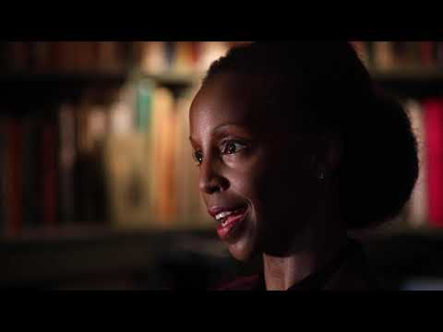
See: Write down observations
Wonder: What questions do you have or that you are curious about?
Connect x 2: How does this connect to what you’ve learned in school, and/or the world around you?
Notes:
http://www.pz.harvard.edu/sites/default/files/See%20Wonder%20Connect%20x2_0.pdf

